Slide 1
Unit 2 – Technology and its effects
Liceo Andrés Bello
English Department
Mr. Díaz

Slide 2
Objective
Comprehend the effects of technology in new scientific advances in communicative contexts

Slide 3
Concepts
01
Technological advances
02
Positive effects
03
Opinions

Slide 4
DAILY CONTEXT

Slide 5
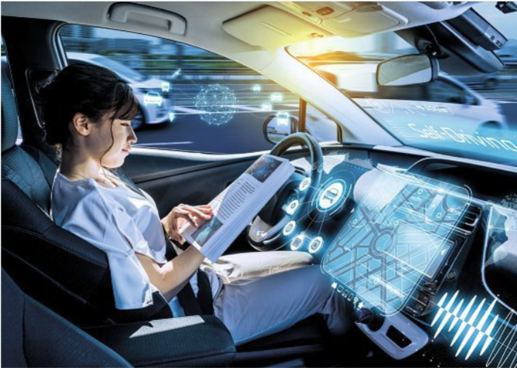
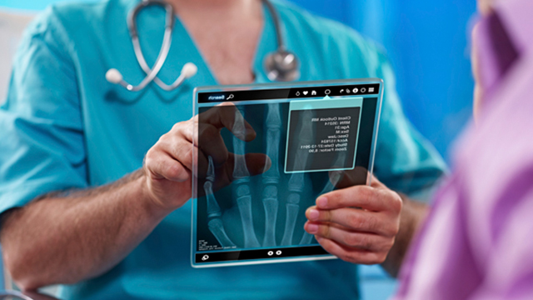
Tech. Advances
5G Data Networks
Personalised and Predictive Medicine
Extended Reality
Autonomous Driving

Slide 6
ICT
TRANSPORT
MEDICINE
EDUCATION
Areas in Technology
COMMUNICATION
LEISURE AND GAMES

Slide 7
Opportunities for connection
Improvement of devices
Job Trading
Mobility
POSITIVE
EFFECTS

Slide 8
What is the importance of the new tech. advances?
Innovation (state-of-the-art)
The self-driving car is the latest innovation for some companies
Development
The development of new devices for education depends on the impact it would take away.
Progress
Regarding the process and progress of 5G networks, we would see if it is possible for new connections
Breakthrough
The new breakthrough of the microchip for the brain, will impact positively to the medicine area
Razzmatazz
The fashion industry is showing razzmatazz using drones and 4D images for their shows

Slide 9
What’s your opinion?
Strong
Neutral
Subjective
GENERAL
PERSONAL POINT OF VIEW
** The general opinion means you involve all the characteristics of something as a whole.
**Personal point of view, as it is set, it is personal and can be divided in three ways:
Strong Opinion → you are completely sure of what you are going to say.
Neutral Opinion → you think but not sure
Subjective Opinion → It is an opinion in accordance with an experience or event you have lived
Introductory phrases: I think / I believe /In my opinion / I strongly believe / I am convinced / From my experience / From my point of view

Slide 10
Examples
Strong Opinion→ I strongly believe, new technological advances could carry lots of amazing benefits to our daily routines, such as at our workplace. ☺
Neutral Opinion → I can say, 5G networks are ok if they give us what we need for communicating.
Subjective → From my point of view, the new versions of phone devices could bring the best in the industry. State-of-the-art products

Slide 11
Question Time
What new advances are there?
01
These advances can only carry positive effects?
02
When giving opinions about new advances, how many ways are there?
03

Slide 12
Activity 1
Using the information given, set three opinions according to any of the concepts worked.
CRITERIA | OPINION
STRONG OPINION
NEUTRAL OPINION
SUBJECTIVE OPINION

Slide 13
ACTIVITY 2
Regarding the following video, answer the questions
QUESTION | ANSWER
What advances has the UoC done considering the applicants?
In their 800 years of history, have they developed new technologies? Give an example
What tech. advance have they used for making the video?
In what area of technology is this video based?
What opinion do you have about the information and tech. devices used on the video?
1.

